Slide 1

PRESENTATION TOPIC : Pointers
Presented By :
MD Dulal Hossain
ID : 213902116
Section : 213 DA
Dapt :CSE ,GUB
Supervised By :
MD Solaiman Mia Assistant Professor Department of CSE ,GUB

Slide 2
Discussion Topic :
1 . Introducation Pointers
2. Call by value
3. Call by reference
1

Slide 3
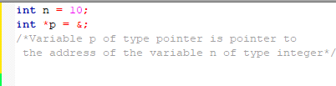
The Pointer in C language is a variable which stores the address of another variable .

Slide 4
call by value
In call by value method, the value of the actual parameters is copied into the formal parameters. In other words, we can say that the value of the variable is used in the function call in the call by value method.

Slide 5
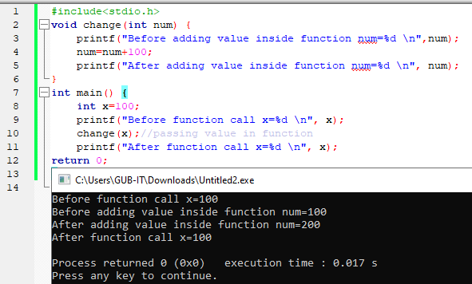
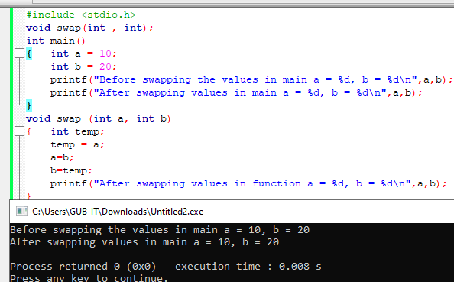
source code : call by value

Slide 6
call by reference
In call by reference, the address of the variable is passed into the function call as the actual parameter.

Slide 7
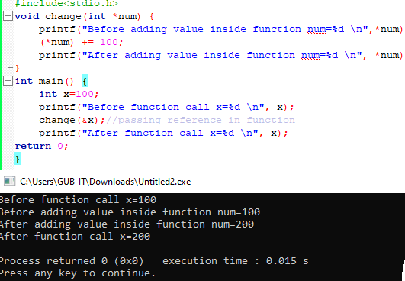
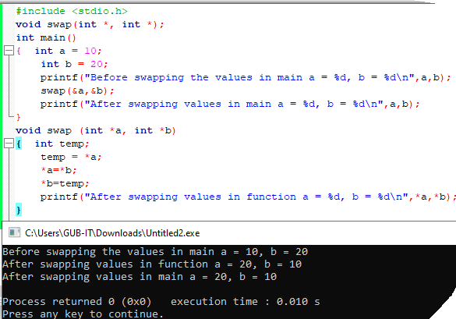
source code : call by reference

Slide 8

Thank you so much

